Slide 1

Analysis of Marston’s Tap

Slide 2
CONTENTS
01
Introduction
02
Price Analysis between menu and Scale up plans to capture other pubs
03
Location within UK
04
Conclusion and Question

Slide 3
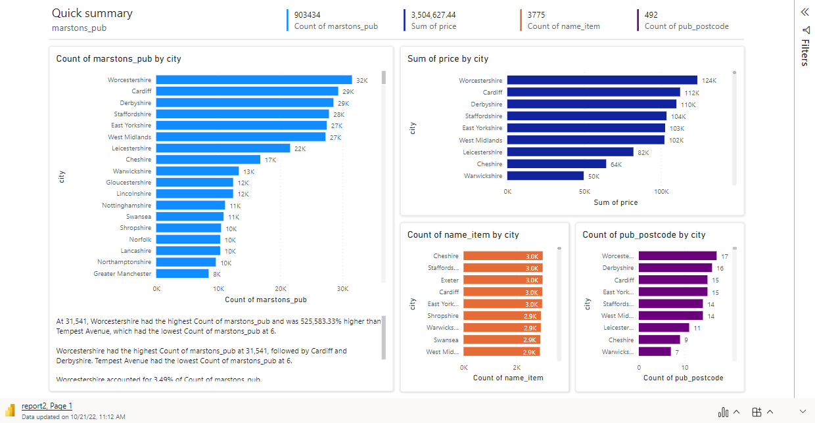
Price Analysis between menu and Scale up plans to capture other pubs
02

Slide 4
02
Price Analysis between menu and Scale up plans to capture other pubs
checking for the traffic in the pub in each hour of the day or week or month
compare host event that are enticing to customers that attracts traffic
compare opening times for each pub locations and competitors
03
Location within UK
Price varies within location
List of menu’s varies based on city
Number of pubs within a location determines the total revenue per month

Slide 5
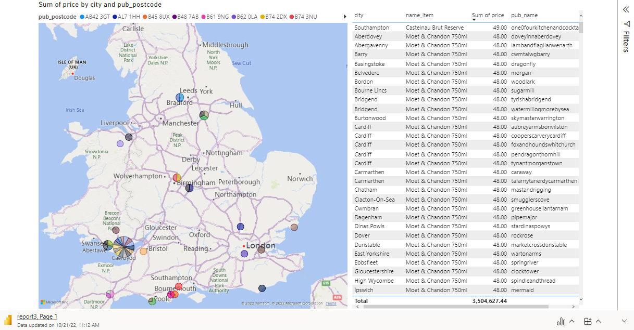
03
Location within UK

Slide 6
04
Conclusion and Question
Compare stonegate menu data with the marstons pub menu data to understand price difference within pubs in same location
Compare opening time for both pubs and check for traffic analysis in the online table book
Limitation of my Analysis
Traffic data not available
Evaluation of Services provided by Stonegate competitors
Detail analysis of Stonegate Competitors menu list across regions
Number of Stonegate pubs in close proximity with competitors
List of Competitors and number of pubs (https://oxforddrinker.camra.org.uk/2022/02/the-nine-pubcos-who-control-over-half-of-all-pubs/)
Punch Taverns (1,282)
Admiral Taverns (1,500)
Star Pubs & Bars (2,500)
Greene King (3,100)
Marston’s (1,400)
Mitchells and Butlers (1,650)
J. D. Wetherspoon (925)
Wellington (850)

Slide 7
THANK YOU

